Slide 1
BIKE BUYER PREDICTION
Pruthviraj Chintakindi
221810302013

Slide 2
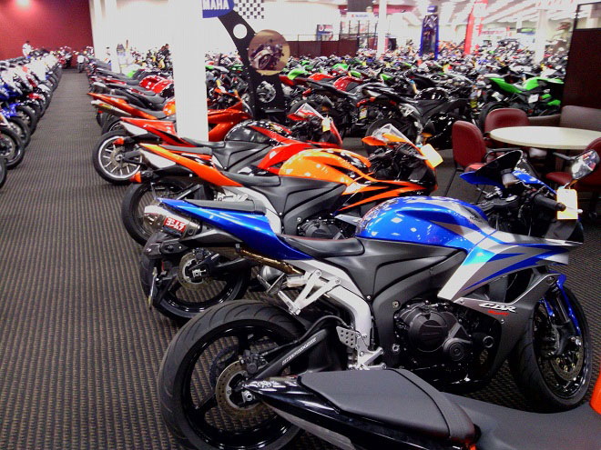
Problem Statement
To predict the sale of a bike based on the customer’s data

Slide 3
Objective
To get a better understanding and chalking out a plan of action for the approach taken and the possibility of a sale that might happen with certain customers. Based on the type of buyers and the information like the number of children, education, occupation, marital status, already having a car, etc the sale or whether the buyer will buy or not is to be predicted.

Slide 4
Dataset Description
Id" : unique id of customer
Gender : Male/Female
Married: Applicant married or not
"Income": Income of customer
"Children": Number of children
"Education": Type of education
"Occupation": Type of occupation
"Homeowner": has a home or not
"Cars": Has car or not
"Commute distance": Distance from home to workplace
"Region": the region to which the customer lives in
"Age": Age of the customer
"Purchased bike ": whether the customer already has a bike or not.

Slide 5
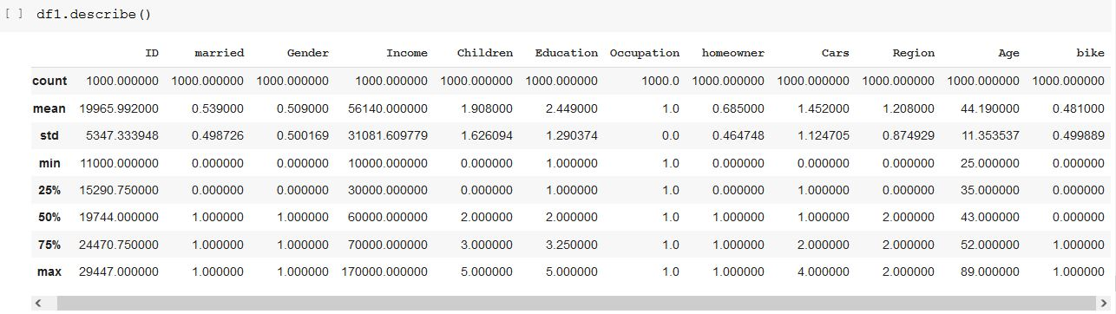
Dataset Description

Slide 6
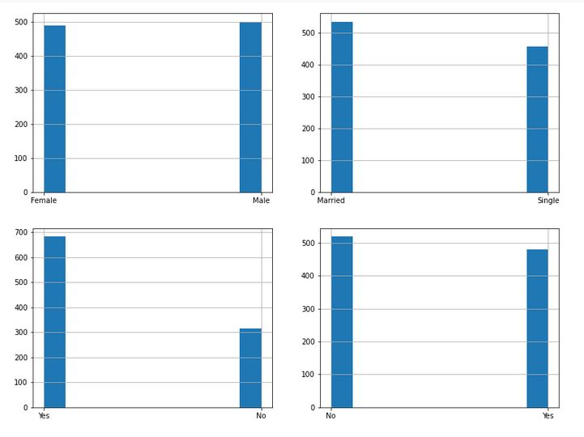
Univariate Analysis
Univariate analysis is when we analyze each variable individually, For categorical features .

Slide 7
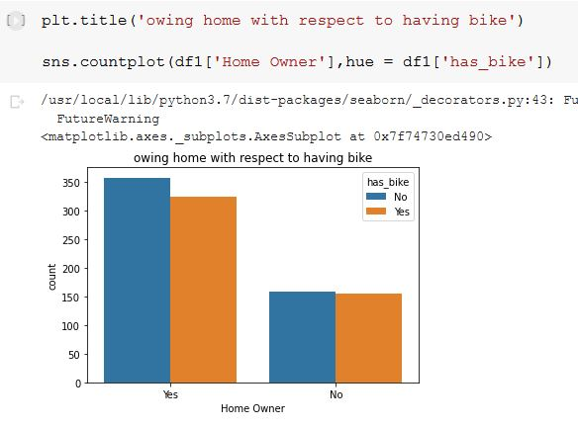
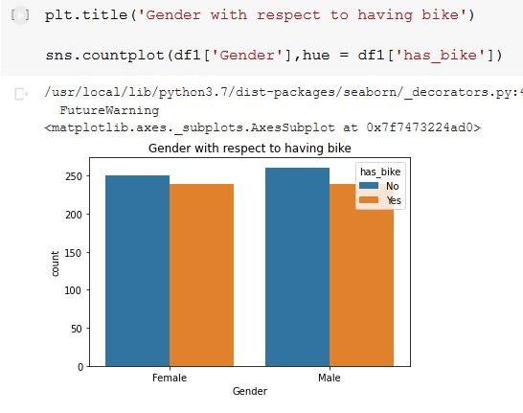
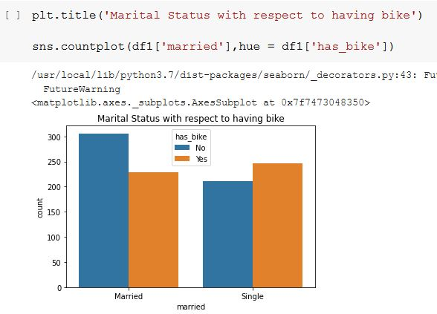
Bivariate Analysis
After looking at every variable individually in univariate analysis, we will now explore them again with respect to the target variable in bivariate analysis.

Slide 8
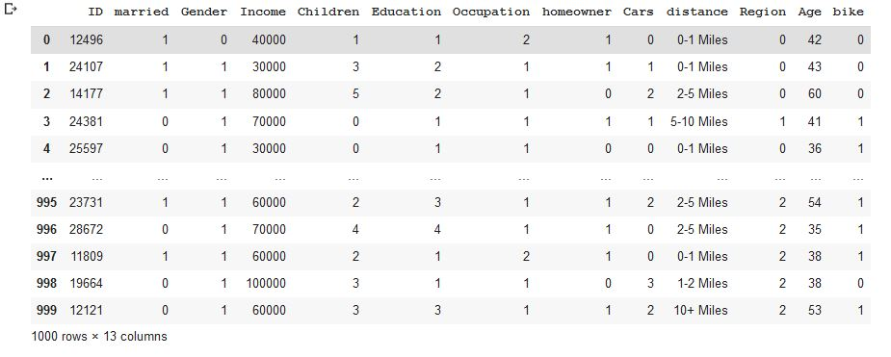
Data preprocessing
Data pre-processing is a data mining technique that involves transforming raw data into an understandable format. Real-world data is often incomplete, inconsistent, and/or lacking in certain behaviours or trends, and is likely to contain many errors. Data pre-processing is a method of resolving such issues.

Slide 9
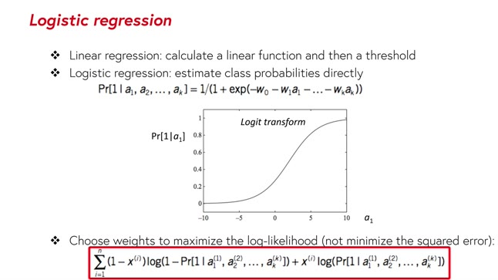
Logistic Regression
Logistic regression is a statistical analysis method used to predict a data value based on prior observations of a data set.
A logistic regression model predicts a dependent data variable by analysing the relationship between one or more existing independent variables.
Logistic Regression is used when the dependent variable(target) is categorical.

Slide 10
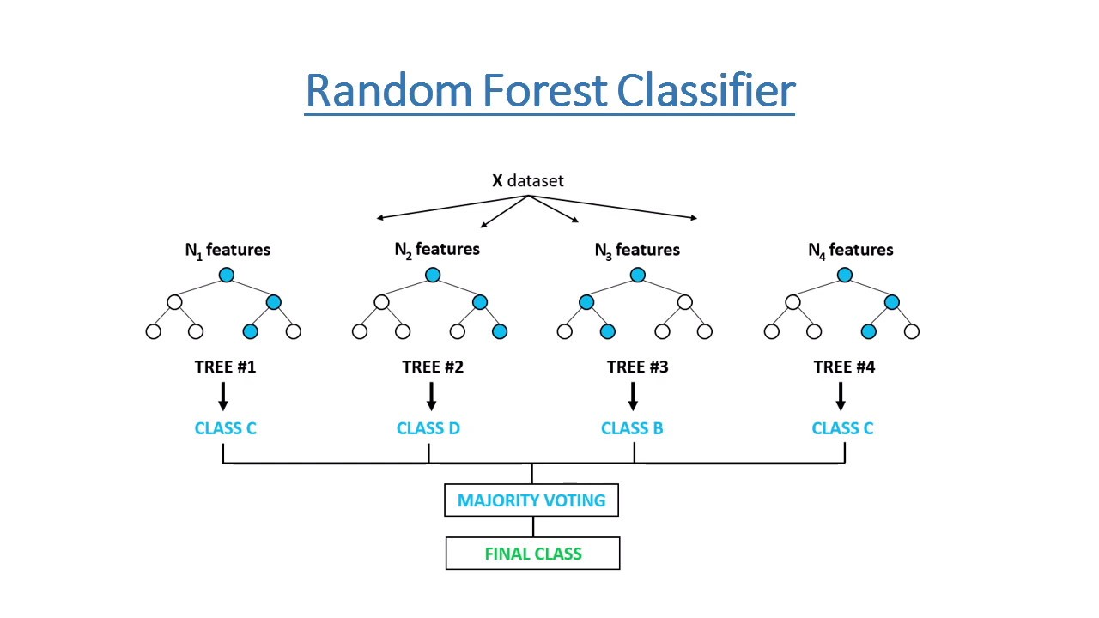
Random Forest
Random Forest Classifier is an ensemble tree-based learning algorithm. The Random Forest Classifier is a set of decision trees from randomly selected subset of training set.
It aggregates the votes from different decision trees to decide the final class of the test object.

Slide 11
Conclusion
Through this project, the prediction of bike buyers over evaluation is made up of a data science model that can be used to predict the sale of a bike based on the customer's data, all classification evaluation metrics are evaluated and this model can be used in any edge devices such as (e.g.: mobile application) as the customer / future prospectus is used.

Slide 12
THANK YOU

